Slide 1
ACTIVITY 1-2 STUDENT HANDOUT: YOU’RE AN EYEWITNESS!
Directions: You will be given 3 minutes to study the following picture. test your powers of observation by answering the questions on the pages afterwards.
Write the questions that follow. Leave space for your answers.
Are you ready?

Slide 2
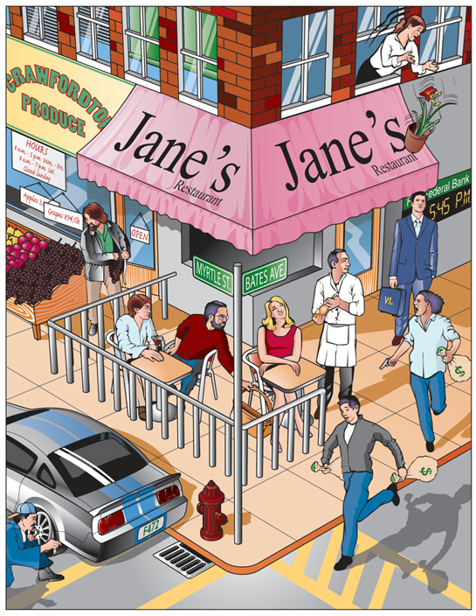

Slide 3
Questions:
What time was it by the bank’s clock? ______________
How many bags of money were visible? ________________
What was the name of the outdoor café? ___________________
On what street was the entrance to the restaurant? ______________
How many thieves were staging the holdup? ______________
Were they armed? _____________
How many bags of money were they carrying? _______________
Was the thief in the street wearing a hat? _________
How many people, besides thieves, were at the robbery? ______
What were the initials of the man carrying the briefcase? ________

Slide 4
11.What danger was he in? ________________________
12. Gender of onlooker from the second floor. __________________
13. What store is next to the café? _________________________
14. What was the shoplifter stealing? ________________________
15. The car has what color of stripes? _______________________
16. How do you know the car was illegally parked? _____________
17. Which part of the car was being vandalized? ________________
18. What kind of hat is the vandal wearing? ________
19. What crime was in progress against the female diner? ________
20. The waiter is going to serve what drink? ___________

Slide 6
What time was it by the bank’s clock? 5:45 p.m.
How many bags of money were visible? Three
What was the name of the outdoor café? Jane’s
On what street was the entrance to the restaurant? Bates Avenue and Myrtle Street
How many thieves are staging the holdup? Two
Were they armed? Yes
How many bags of money were they carrying? Three
Was the thief in the street wearing a hat? No
How many people, besides the holdup men, were at the robbery? Eight
What were the initials of the man carrying the briefcase? VL

Slide 7
What immediate danger was he in? Flowerpot falling on his head
Was the onlooker from the second floor a man or a woman? Woman
Which store was next to the café? Crawfordton Produce
What was the shoplifter stealing? Grapes
What was the license number of the car parked in front of the store? F472
How do you know the car was illegally parked? Parked next to a fire hydrant.
Which part of the car was being vandalized? Stealing Hubcap
What type of hat is the person wearing who is vandalizing the car? Baseball cap
What offense was in progress against the female diner? Purse snatching
The waiter is going to serve what drink? Wine or champagne.

