Slide 1

Section 2: Mathematics and Physics
We use math to express concepts in physics.
K What I Know | W What I Want to Find Out | L What I Learned

Slide 2
Essential Questions
Why do scientists use the metric system?
How can dimensional analysis help evaluate answers?
What are significant figures?
Mathematics and Physics
Copyright © McGraw-Hill Education

Slide 3
Vocabulary
Review
SI
New
dimensional analysis
significant figures
Mathematics and Physics
Copyright © McGraw-Hill Education

Slide 4
Mathematics in Physics
Physicists often use the language of mathematics.
Physicists rely on theories and experiments with numerical results to support their conclusions.
Mathematics and Physics
Copyright © McGraw-Hill Education

Slide 5
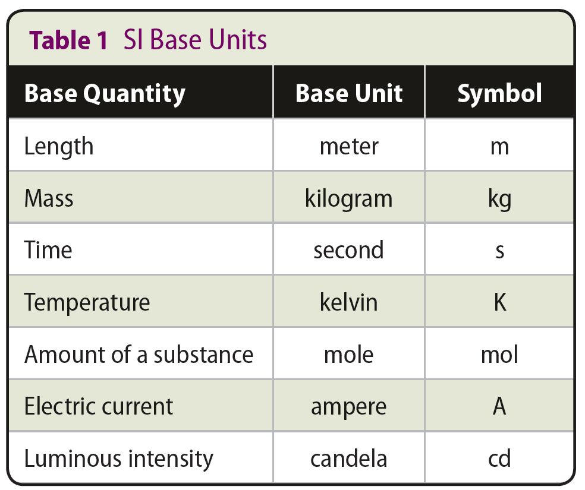
SI Units
The worldwide scientific community uses an adaptation of the metric system called Systeme International d’Unites or SI.
The SI system of measurement uses seven base quantities.
Other units, called derived units, are created by combining the base units in various ways.
Mathematics and Physics
Copyright © McGraw-Hill Education

Slide 6
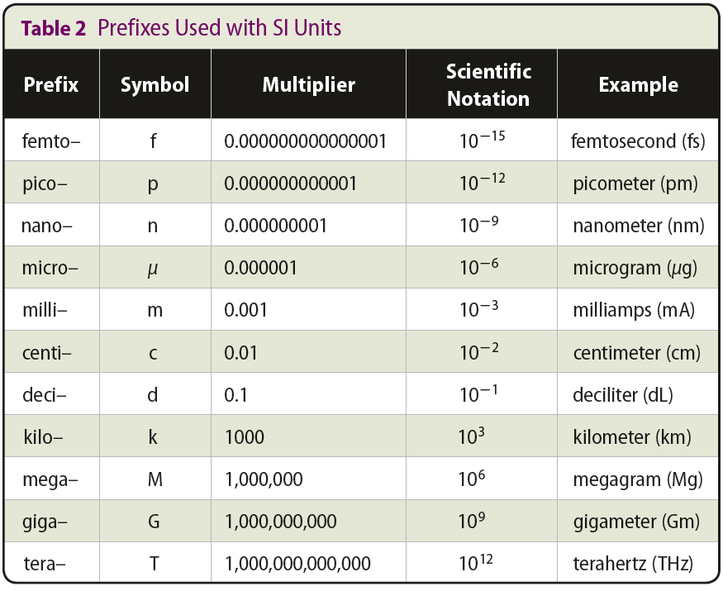
SI Units
Prefixes are used to change SI base units to powers of 10.
Mathematics and Physics
Copyright © McGraw-Hill Education

Slide 7
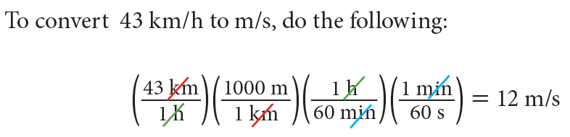
Dimensional Analysis
Dimensional analysis is a method of treating the units as algebraic quantities, which can be cancelled.
Dimensional analysis can be used to
  Check that you have set up a problem correctly
  Check that your answer is in the correct units
  Choose conversion factors
Example:
Mathematics and Physics
Copyright © McGraw-Hill Education

Slide 8
Dimensional Analysis
Practice Problems
Convert 32 cm/s to km/h.
Determine the units for energy using the formula for kinetic energy:
Kinetic energy = × mass × (velocity)². Recall that the unit of mass is kilograms and that velocity is measured in meters per second.
Mathematics and Physics
Copyright © McGraw-Hill Education

Slide 9
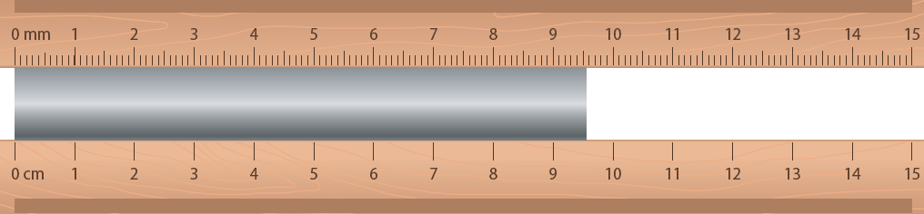
Significant Figures
All measurements are approximate and have significant figures. The last digit given for any measurement is the uncertain digit.
Significant figures are the valid digit in a measurement.
The number of significant figures depends on the precision of the measuring device.
Using the upper measuring tool:
The length is between
9.50 cm and 9.60 cm.
The measurement would be estimated to the nearest hundredth of a centimeter.
Using the lower measuring tool:
The length is between
9.0 cm and 10 cm.
The measurement would be estimated to the nearest tenth of a centimeter.
Mathematics and Physics
Copyright © McGraw-Hill Education

Slide 10
Significant Figures
Rules of Significant Figures
Nonzero digits are significant.
Final zeros after a decimal point are significant
Zeros between two significant figures are significant.
Zeros used only as placeholders are not significant.
Exact Numbers
Counting numbers have an infinite number of significant figures.
Conversion factors have an infinite number of significant figures.
Mathematics and Physics
Copyright © McGraw-Hill Education

Slide 11
Significant Figures
Practice Problems
State the number of significant figures in each measurement.
  5.0 mL
  2.9979×10⁸ m/s
  2.50 km
  10,500 pF
Complete the following calculations using the correct number of significant figures.
  5.012 m + 3.4 m + 2.33 m
  3.40 m ÷ 6.5 s
  807 m/s² × 5.5 s
  610 mA − 500 mA
  2 significant figures
  5 significant figures
  3 significant figures
  3 significant figures
  10.7 m
  0.52 m/s
  4,440 m/s
  100 mA
Mathematics and Physics
Copyright © McGraw-Hill Education

Slide 12
Solving Problems
THE PROBLEM
Read the problem carefully.
Be sure you understand what is being asked.
Use with Example Problem 1.
Problem
When a car travels at a speed of
110 km/h for 4.0 h, how far did the car travel?
Response
ANALYZE AND SKETCH THE PROBLEM
ANALYZE AND SKETCH THE PROBLEM
Read the problem again.
Identify what you are given, and list the known data.
Identify and list the unknowns.
Plan the steps you will follow to find the answer.
known
speed = 110 km/h
time = 4.0 h
unknown
distance = ? km
Mathematics and Physics
Copyright © McGraw-Hill Education

Slide 13
Solving Problems
Use with Example Problem 1.
Problem
When a car travels at a speed of
110 km/h for 4.0 h, how far did the car travel?
Response
ANALYZE AND SKETCH THE PROBLEM
known
speed = 110 km/h
time = 4.0 h
unknown
distance = ? km
SOLVE FOR THE UNKNOWN
If the solution is mathematical, write the equation and isolate the unknown factor.
Substitute the known quantities into the equation.
Solve the equation.
SOLVE FOR THE UNKNOWN
Use the relationship among speed, distance, and time to solve for the car’s speed.
speed = distance / time
distance = speed × time
  = 110 km/h × 4.0 h
  = 440 km
Mathematics and Physics
Copyright © McGraw-Hill Education

Slide 14
Solving Problems
EVALUATE THE ANSWER
440 km is about 270 miles, which is reasonable for a car going 110 km/h (about 65 mph).
The answer is in km, which is correct for distance.
Each of the known values has two significant figures, as does the answer.
Use with Example Problem 1.
Problem
When a car travels at a speed of
110 km/h for 4.0 h, how far did the car travel?
Response
ANALYZE AND SKETCH THE PROBLEM
known
speed = 110 km/h
time = 4.0 h
unknown
distance = ? km
EVALUATE THE ANSWER
Check your math.
Reread the problem. Is the question answered?
Is the answer reasonable?
Are the units and the significant figures correct?
SOLVE FOR THE UNKNOWN
Use the relationship among speed, distance, and time to solve for the car’s speed.
speed = distance / time
distance = speed × time
  = 110 km/h × 4.0 h
  = 440 km
Mathematics and Physics
Copyright © McGraw-Hill Education

Slide 15
Review
Essential Questions
Why do scientists use the metric system?
How can dimensional analysis help evaluate answers?
What are significant figures?
Vocabulary
dimensional analysis
significant figures
Mathematics and Physics
Copyright © McGraw-Hill Education

