Slide 1
Mr. Waddell’s Forensic Science 1
Ch-1 Activity: Learning to See
Take a clean sheet of notebook paper and title it as above.
Then in the upper right corner write your name, today’s date, and this class period.

Slide 2
Observation skills
During this activity, you will be shown several photographs.
You will have 30 seconds to view each photo. Please, do not write anything down or make notes.
This activity is between your eyes and your brain.
These photographs are displayed for 30 seconds. Self-timed.

Slide 3
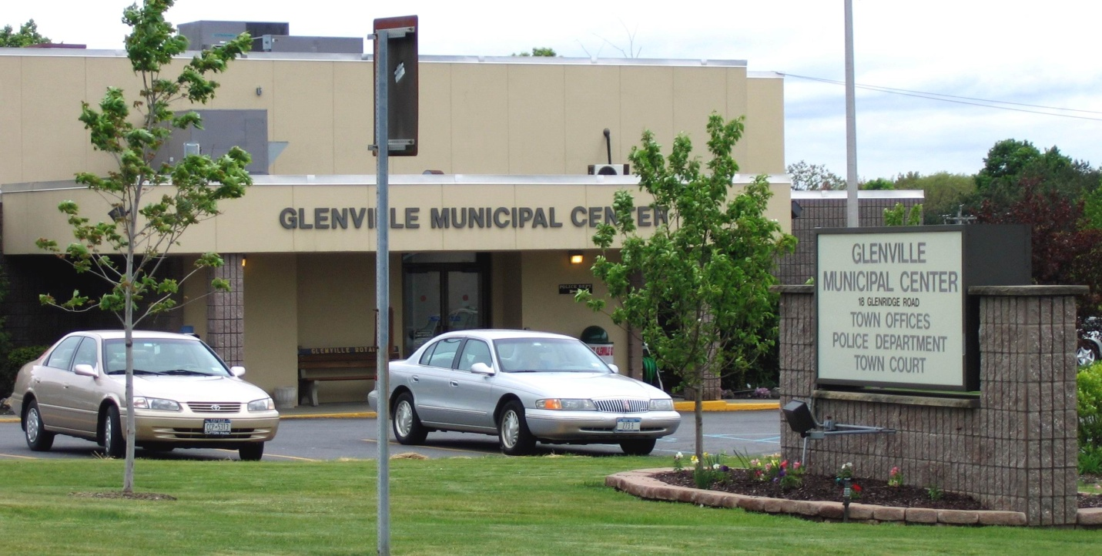

Slide 4
Questions: Photograph #1
Name the CENTER where the photograph taken?
How many complete cars are pictured?
What color(s) are the cars?
What types of offices are located in the CENTER?
How many small trees are in the picture?
The photograph was taken in New York State during what season of the year?
How many people are in the photograph?

Slide 5
Answers
At what location was the photograph taken? Glenville Municipal Center
How many cars are pictured? 2
What are the colors of the cars? Tan and gray
What types of offices are located in the building? Town, police, and court offices
How many small trees are in the picture? 2
The photograph was taken in New York State during which season? Spring or summer
How many people are in the photograph? None

Slide 6
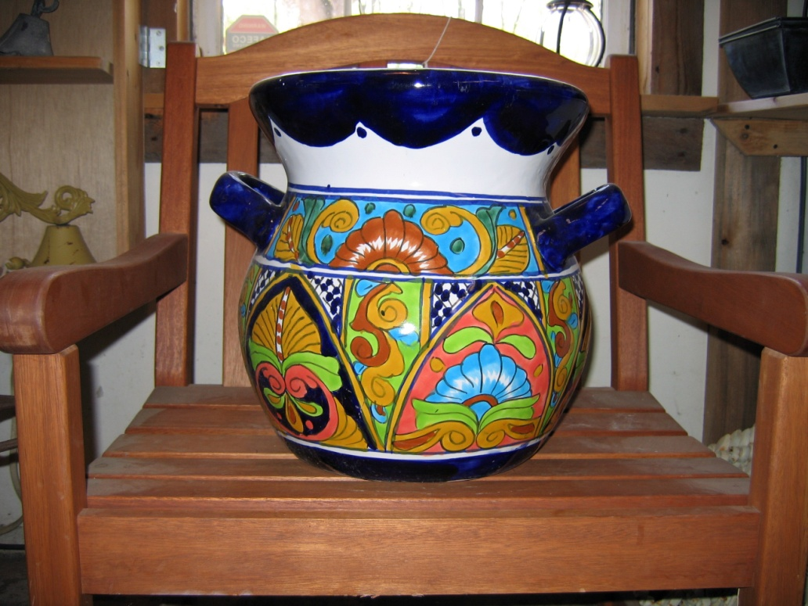

Slide 7
Photograph #2
What is the object of Photograph #2?
Describe the shape of the object pictured.
What are the colors of the object?
What color edges the top of the object?
What is the object sitting on?
What is the approximate size of the object? (Estimate by what it is sitting on)

Slide 8
Answers
What is pictured in Photograph #2? Urn or flowerpot
Describe the shape of the object pictured. Like a flowerpot
What are the colors of the object? Red, green, tan, blue, white, brown
What color edges the top of the object? Blue
What is the object sitting on? A wooden chair
What is the approximate size of the object? About 12–14" wide, about 16" tall

Slide 9
Ready for next photo?

Slide 10
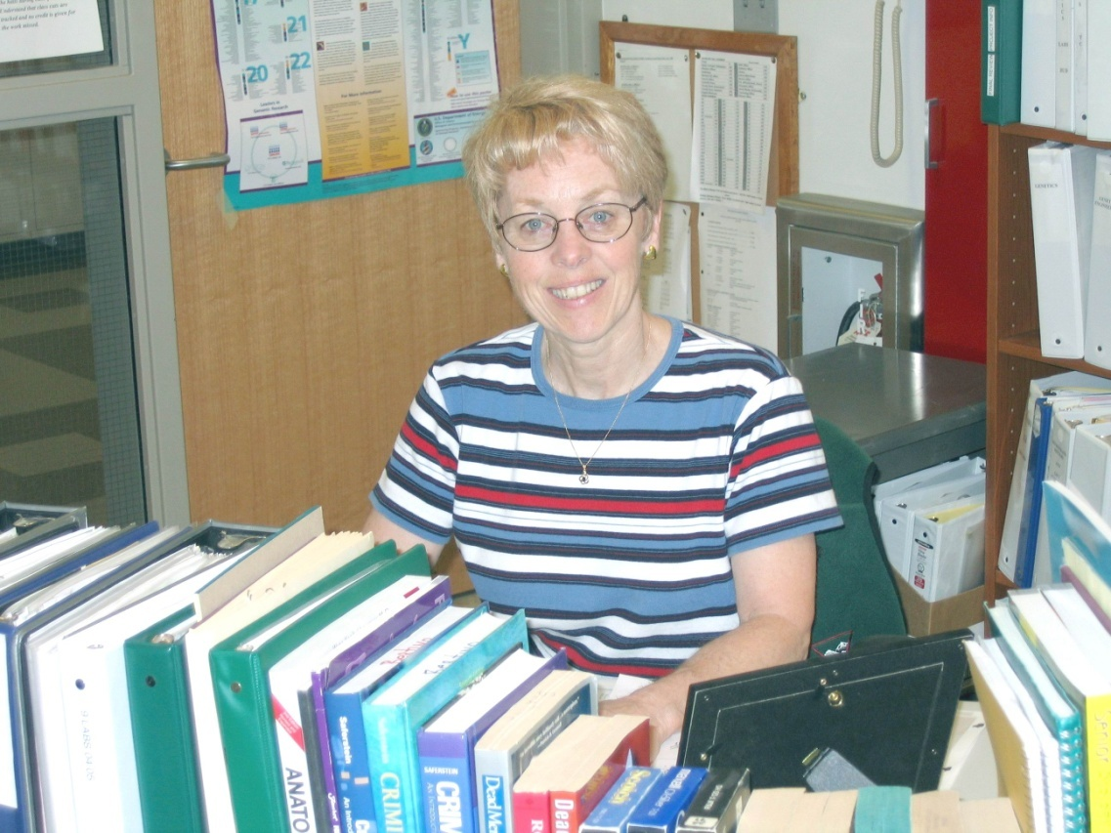

Slide 11
Photograph #3
How many people are in Photograph #3?
What is the gender of the person in the picture?
What is the approximate age of the person in the photograph?
What is the person’s hair color?
Does the person have long hair or short hair?
Does the person wear glasses?
Is the person wearing any jewelry?
Can you describe where the picture was taken?
Based on evidence in the photograph, can you form a hypothesis about the person’s occupation?
Is it possible to identify the interests of the person based on evidence in the room?

Slide 12
How many people are in Photograph 3? One
What is the gender of the person in the picture? Female
What is the approximate age of the person in the photograph? 50ish
What is the color of the person’s hair? Blonde
Does the person have long hair or short hair? Short
Does the person wear glasses? Yes
Is the person wearing any jewelry? Gold necklace and earrings
Can you describe where the picture was taken? Schoolroom or office
Based on evidence in the photograph, can you form a hypothesis about the person’s occupation? Teacher
Is it possible to identify the interests of the person based on evidence in the room? She is likely interested in science or forensics, or she is a teacher.

Slide 13
THE END!

