Slide 1

Welcome to Forensic Science!
Mr. Waddell & Mr. Knowlton PHS
So, what is Forensic Science?

Slide 2
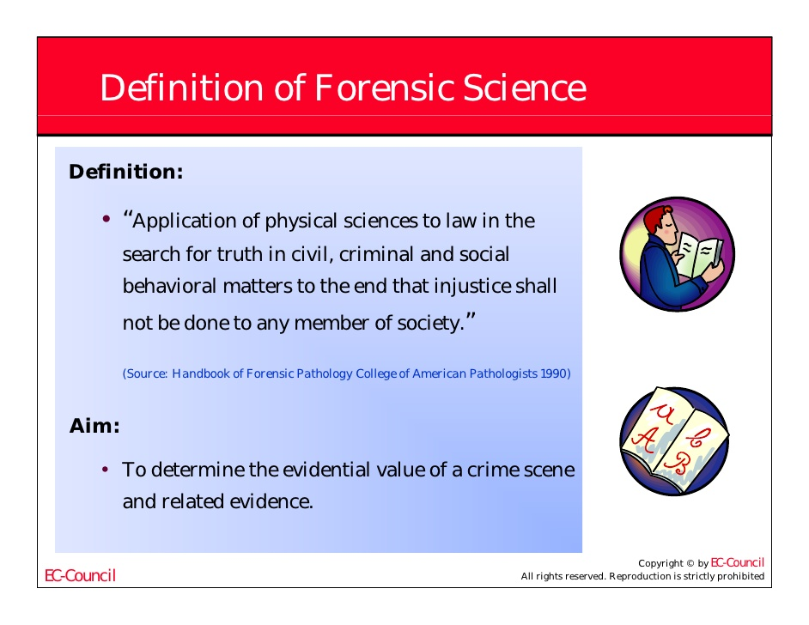

Slide 3
When we as Crime Scene Investigators examine a scene in which a crime has been committed, we must be very careful and notice everything!
We simply use observation to detect objects, weapons, blood, drugs, and victims.
You will need a sheet of paper for this observation exercise.

Slide 4
Using your powers of observation,
find as many differences as possible between the two sides. There are two images on the next slide.
You may want to write the differences as you find them.
You will have one minute. (self-timed slide)

Slide 5
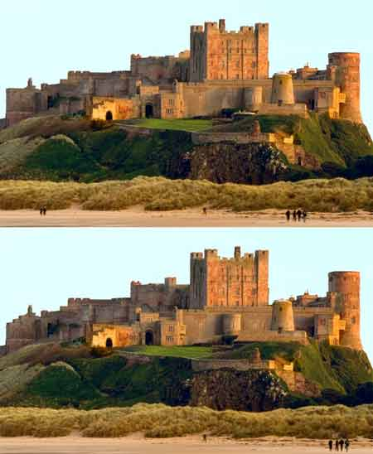

Slide 6
How many did you find?

Slide 7
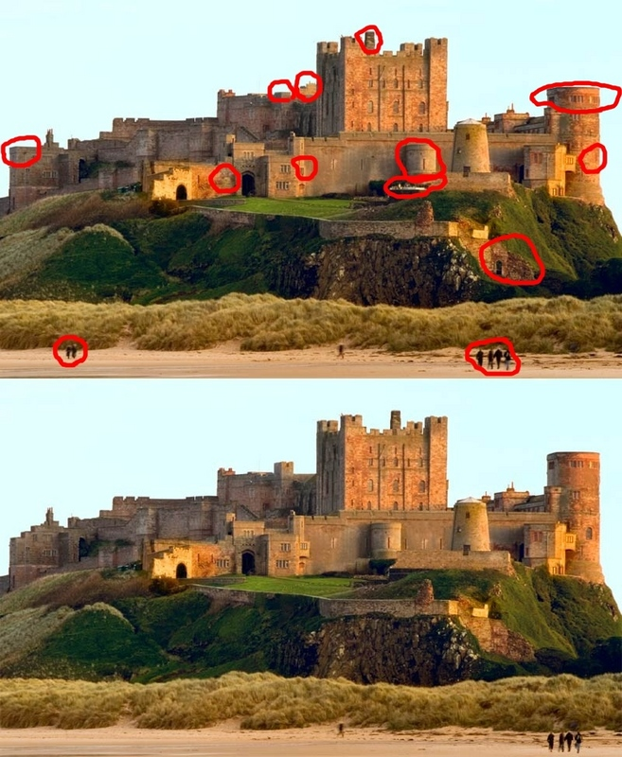

Slide 8
Observations form a very important component of Forensics.
Therefore, use your power of LOOKING in order to determine the object in each of the following slides.
Write down what you see.

Slide 9
You decide what you see on the next slide.
You have 7 seconds.
Please write what you see.

Slide 10


Slide 11
How many of you saw an elderly woman?
How many of you saw a young lady (looking away)?
How many of you saw both?

Slide 12
You decide what you see on the next slide.
The dress is what two colors?
You have 7 seconds.
Write what you see!

Slide 13
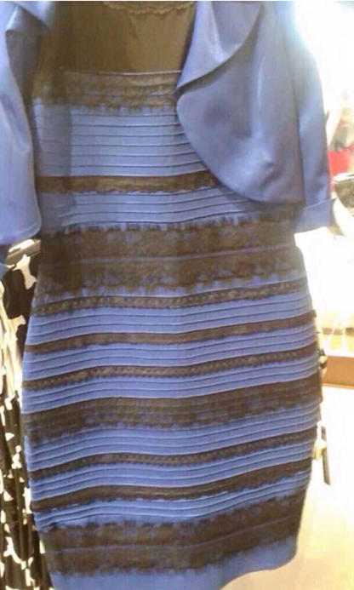

Slide 14
What did you see?
How many saw a black and blue dress?
How many saw and white and gold dress?

Slide 15
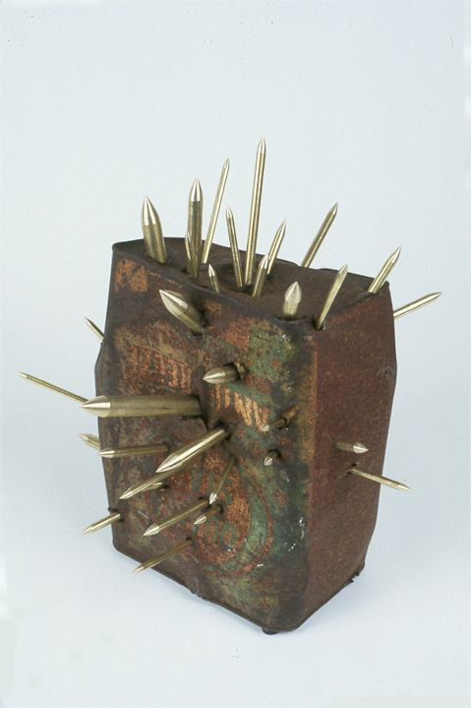


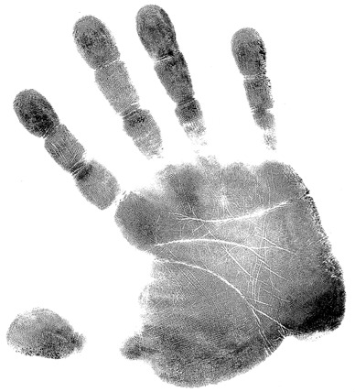
Course Syllabus & Expectations
Materials
Course Content
Expectations

Slide 16
A word about cell phones:
Cell phones are NOT allowed in this classroom!
  Exceptions:
    When I request that you do a topic web-search.
    When we play Kahoot! in class.
A Test-grade will automatically be assigned at the end of the nine-weeks:
  100 points for NOT violating this agreement.
  Each time I see your phone you will lose 5 points from this assigned grade.

Slide 17

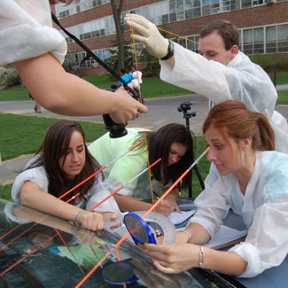
Course Syllabus & Expectations
Grading
Attendance
Classroom Behavior

Slide 18

Course Syllabus & Expectations
Any questions?

Slide 19
A crime scene is any location that may be associated with a committed crime.
Crime scenes contain physical evidence that is pertinent to a criminal investigation.
This evidence is collected by crime scene investigators and law enforcement.
The location of a crime scene is where the crime took place or any area that contains evidence from the crime itself.
Scenes are not only limited to a location, but can be any person, place, or object associated with the criminal behaviors that occurred.

Slide 20
Each student will receive two sheets of printer paper. You will sketch/draw on both sides. One scene per side.
I need a volunteer to pass out copy paper for drawing several crime scenes.
I need another to pass out rulers.
So, get your color pencils and a ruler.
This activity may take more than one class period.

Slide 21
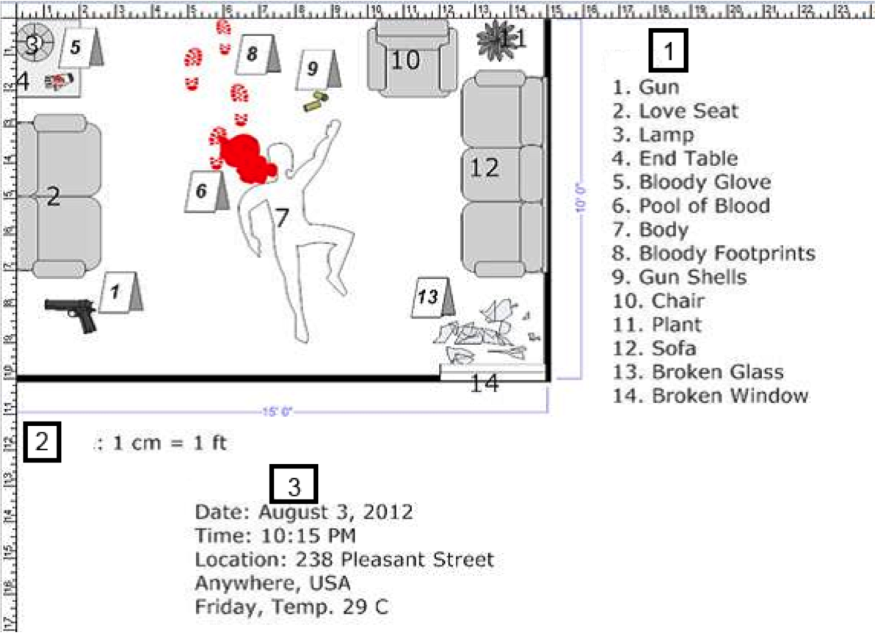
Student: Be sure to add the labels and item numbers. Do not draw the rulers.
Put your
Name and Class Period Here!

Slide 22
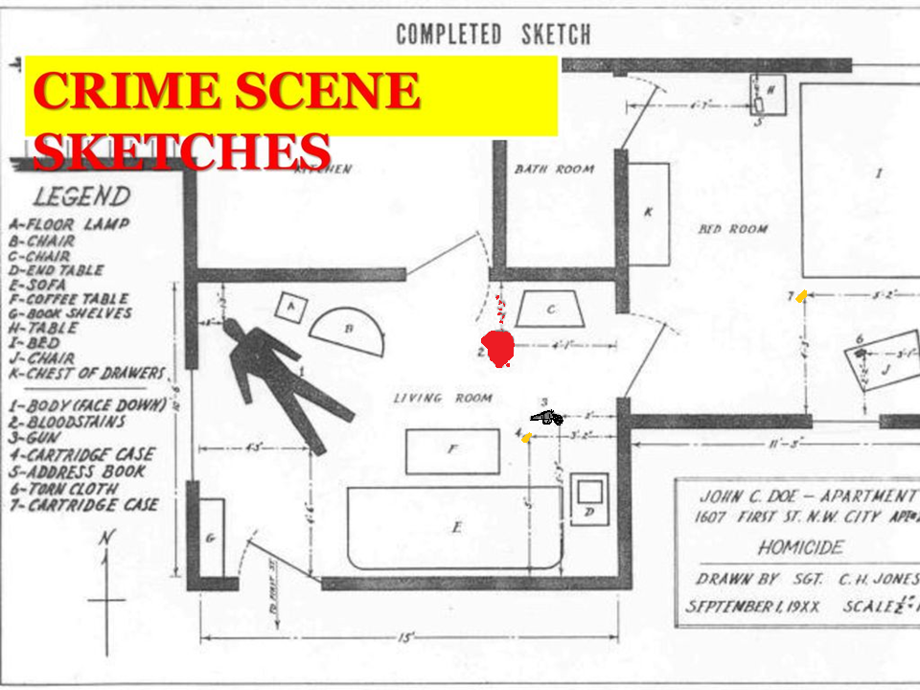
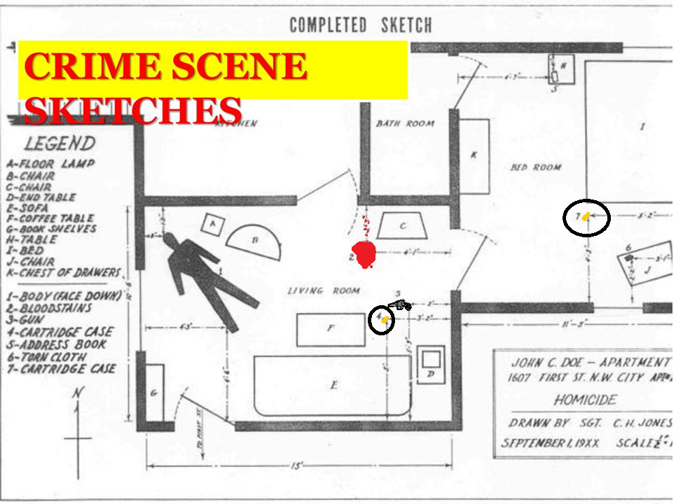

Slide 23
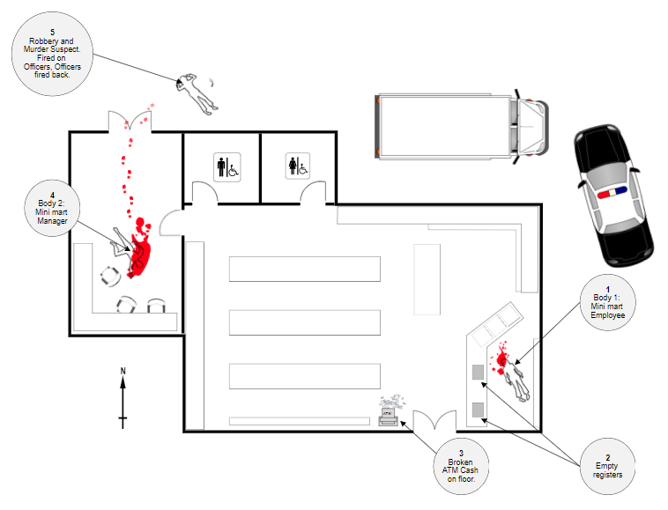



5: Murder and Robbery
Suspect
4: Body 2
Mini-mart
Manager
1: Body 1
Mini-mart
Employee
Put your
Name and Class Period Here!
3: Broken
ATM, cash on floor
2: Empty
Registers

Slide 24
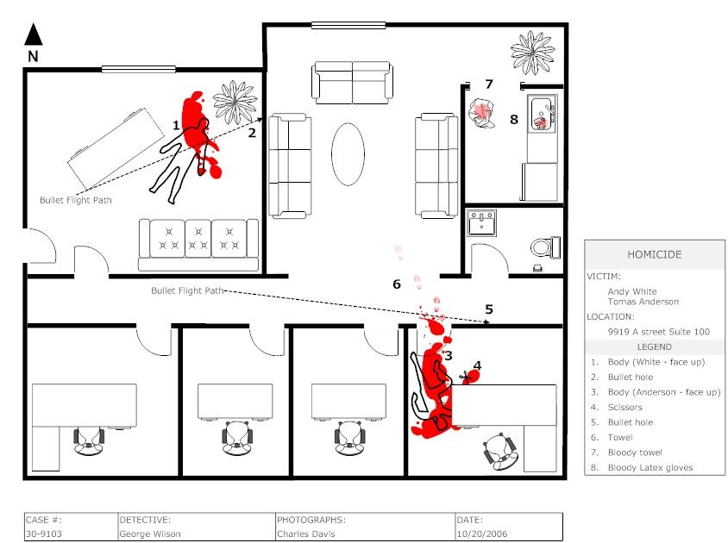

Slide 26

Popcorn
Class Introductions

