Slide 1
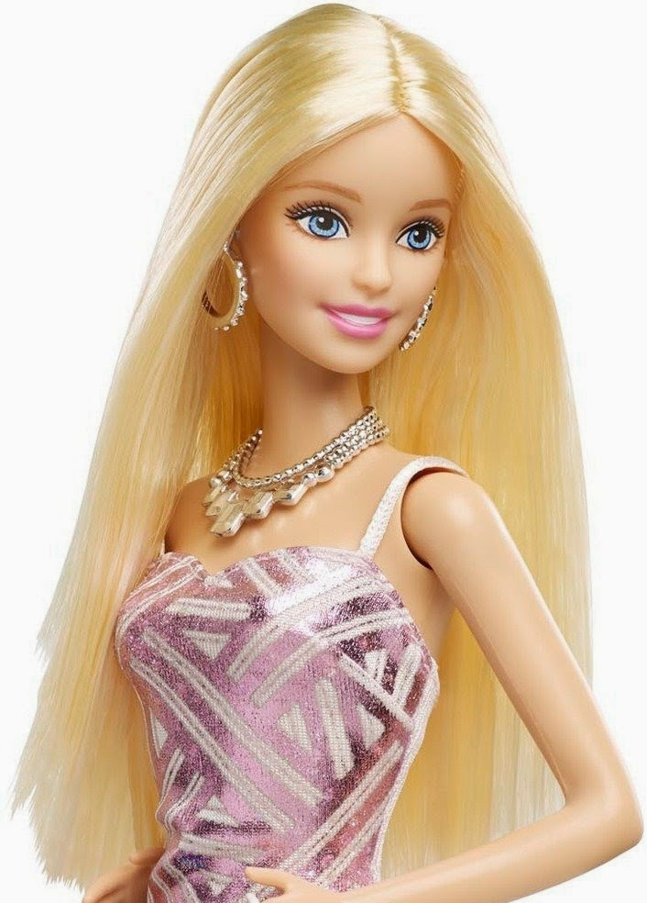
Aspiring Actress Shot to Death
Brenda McArthur Murdered
In libris graecis appetere mea. At vim odio lorem omnes, pri id iuvaret partiendo. Vivendo menandri et sed. Lorem volumus blandit cu has.Sit cu alia porro fuisset.
Ea pro natum invidunt repudiandae, his et facilisis vituperatoribus. Mei eu ubique altera senserit, consul eripuit accusata has ne. Ignota verterem te nam, eu cibo causae menandri vim. Sit rebum erant dolorem et, sed odio error ad.Vel molestie corrumpit deterruisset ad, mollis ceteros ad sea.
AP) Late last Saturday night or early Sunday morning, 22-year-old Brinda McArthur was shot to death according to local police. No suspect is currently in custody. Investigations continue.
In libris graecis appetere mea. At vim odio lorem omnes, pri id iuvaret partiendo. Vivendo menandri et sed. Lorem volumus blandit cu has.Sit cu alia porro fuisset.
Ea pro natum invidunt repudiandae, his et facilisis vituperatoribus. Mei eu ubique altera senserit, consul eripuit accusata has ne. Ignota verterem te nam, eu cibo causae menandri vim. Sit rebum erant dolorem et, sed odio error ad.Vel molestie corrumpit deterruisset ad, mollis ceteros ad sea.

Slide 2
Background: Brenda McArthur
Brenda McArthur, a 22-year-old female, recently graduated from University of West Florida with a Bachelor of Arts in Theatre, with specialty in Acting, has been found dead.
She had been dating her boyfriend, Calvin James, off and on for four years.
They plan an engagement as soon as he finishes his degree at Technical Tech.
Ms. Brenda McArthur

Slide 3
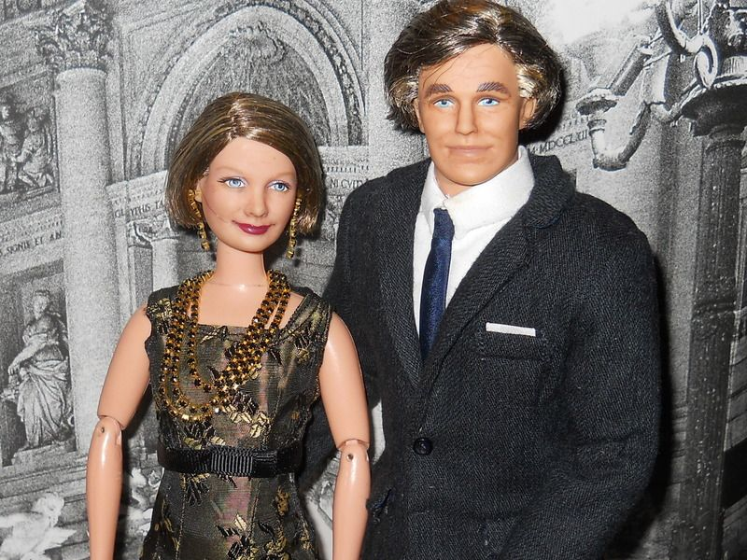
Brenda’s parents have had a history of differences and difficulties with her.
Her point of view was that no matter what she did she was always wrong.
She insisted on pursuing a career as a model, actress and/or writer. She had no interest in becoming a lawyer like her father and grandfather.
Robert McArthur
Brenda’s father and mother are divorced. Her father now lives in another state.
Juliette McArthur

Slide 4
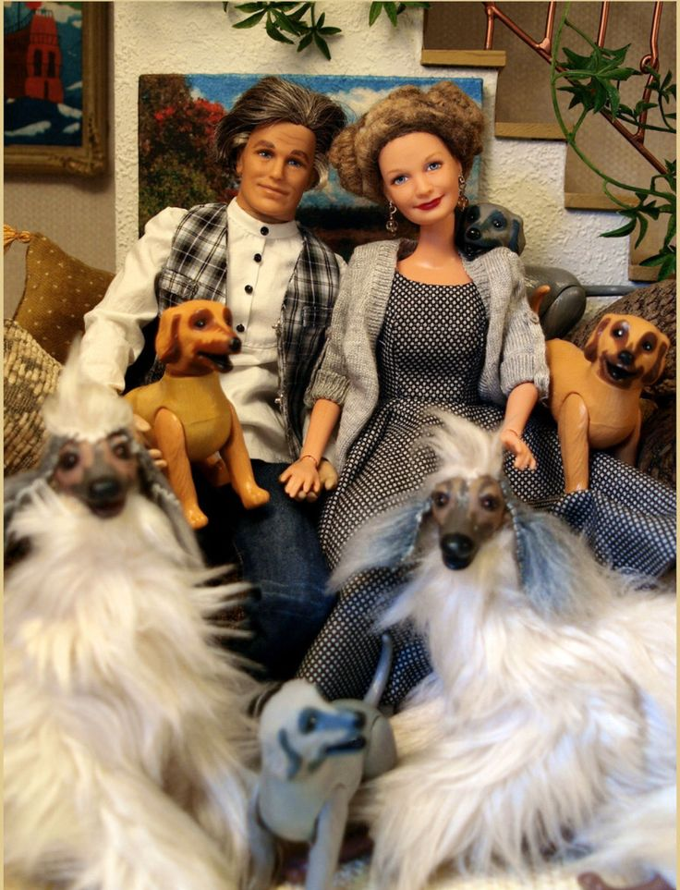
Brenda’s Paternal Grandparents They love dogs!

Slide 5
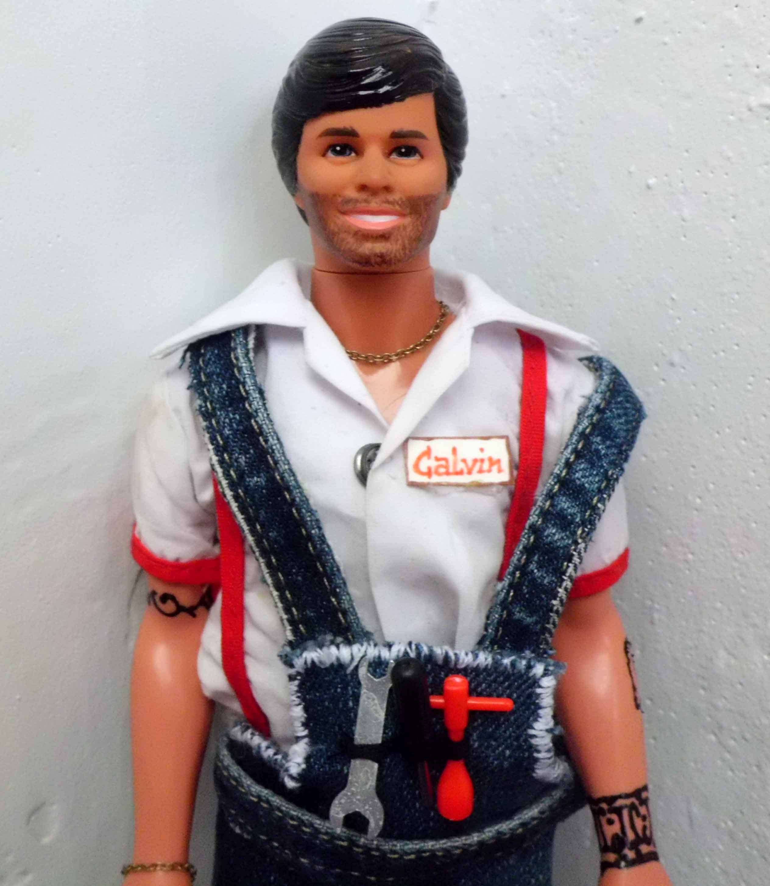
Background: Calvin James
Calvin James is a 24-year-old auto mechanic who hopes to become the owner of a chain of automobile service stores.
Calvin currently works in his father's car repair business while attending tech classes.

Slide 6
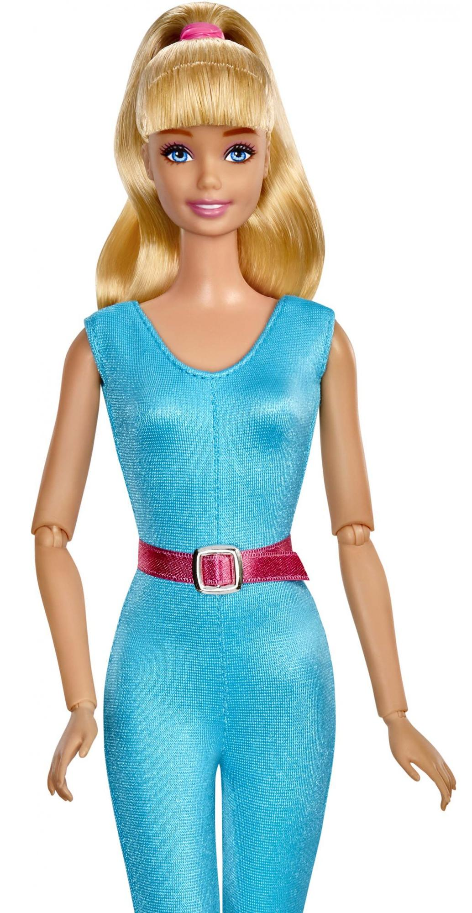
Brenda’s mother is opposed to Brenda having anything to do with Calvin. She doesn’t like him as she sees him to be beneath Brenda’s station. (He is not rich.)
Brenda McArthur

Slide 7
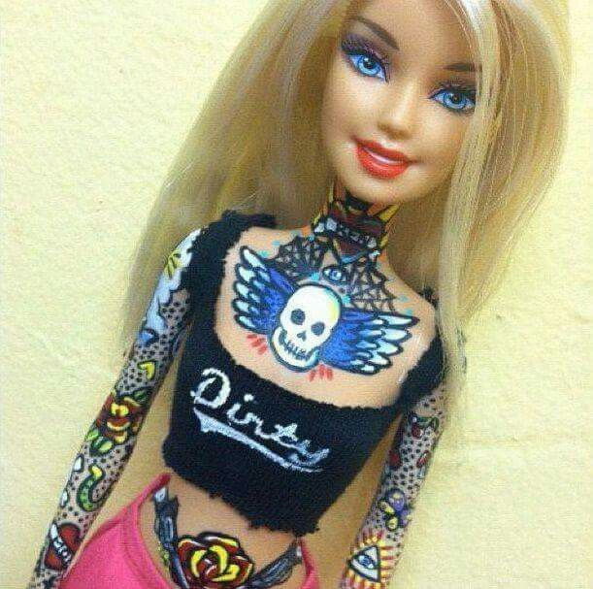
Brenda had just been offered a supporting role in Galactic Studios new film, Bloody Tuxedo. Galactic Studios is located in Hollywood California.
Brenda’s character ultimately gets murdered in the film.
Brenda in character for Bloody Tuxedo.

Slide 8
Maria Garcia, Brenda’s best friend since high school, attends the same university.
They regularly compete in local and state beauty pageants. Which Brenda frequently won.
Maria Garcia

Slide 9
Brenda and her mother live in large one-family home on a cul-de-sac on Hight Street at the north end of town.
The house is a two story, five-bedroom, seven-bath home with a large front yard and larger backyard. All bedrooms are located on the second floor. Entrance to the house is made through any of the five exterior doors.

Slide 10
Saturday Night (about midnight)

Slide 11
Possible Crime Timeline as Reconstructed by Detectives:
The house silent alarm was triggered on Saturday night about midnight.
The Alarm Company called the police.
Patrolman Isaac Henry responded and caught an individual attempting to flee the property. Possibly from the vicinity of the west door.

Slide 12
Brenda’s bedroom
Tool marks found here.

Slide 13
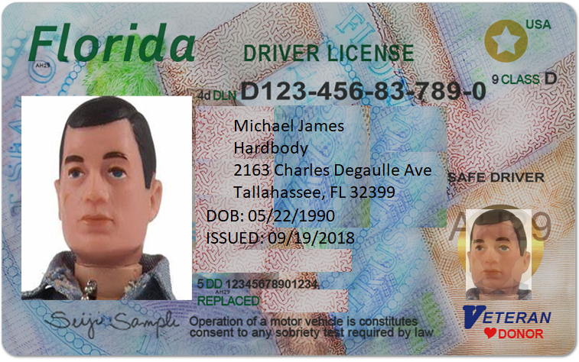
Based on his driver’s license, he was identified as Mike Hardbody.

Slide 14
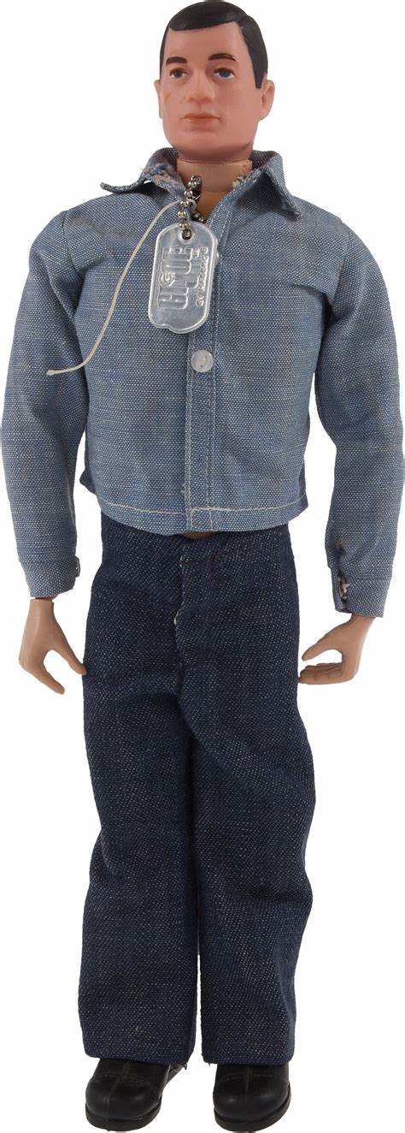
Possible Crime Timeline : (continued)
Visible signs of multiple attempts to gain entry around the house were found (tool marks).
He also possessed B&E tools.
Mike Hardbody

Slide 15
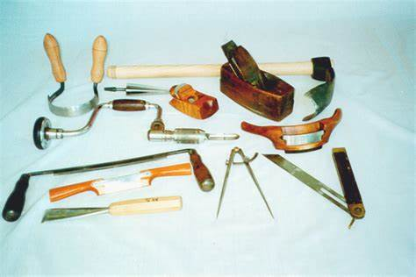
B & E Tools
Every jurisdiction has different definitions of burglary tools, but they usually include: (Having any of these on your person will get you arrested.)
Crowbars, slim jims, and other prying devices
Lock picks and devices used for opening/decoding locks
Screwdrivers, pliers, hammers, and other common hand tools

Slide 16
B & E Tools Continued
Ropes for climbing
Masks, gloves, and other clothing used to hide identity or fingerprints
Heavy duty tools capable of burning through concrete, steel, and other solid materials, such as torches and thermal lances
Explosives like dynamite or gunpowder
This list is not complete!

Slide 17
Possible Crime Timeline : (Continued)
The doors remained secure; however, nobody answered the door nor the phone when the police checked.
The alarm company reset the alarm system from their office
Police did not enter the home.
Hardbody was taken into custody and charged with attempted B&E and possession of B&E tools.

Slide 18
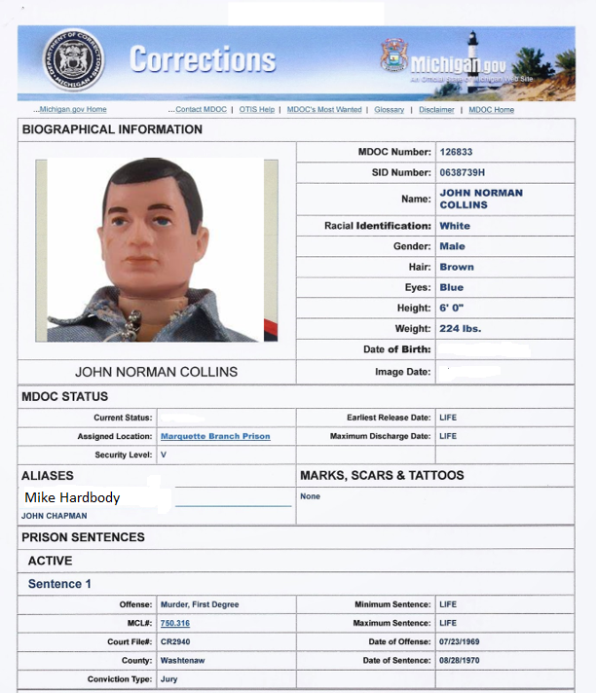
Using fingerprints, police found that Hardbody has a criminal record in Michigan.
John Norman Collins is his real name. His sentence was LIFE for murder. Clerical error allowed him to be released.
He then fled to Florida and changed his name.

Slide 19
Sunday Morning (next day)

Slide 20
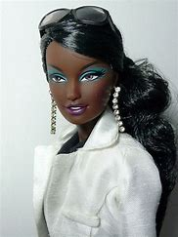
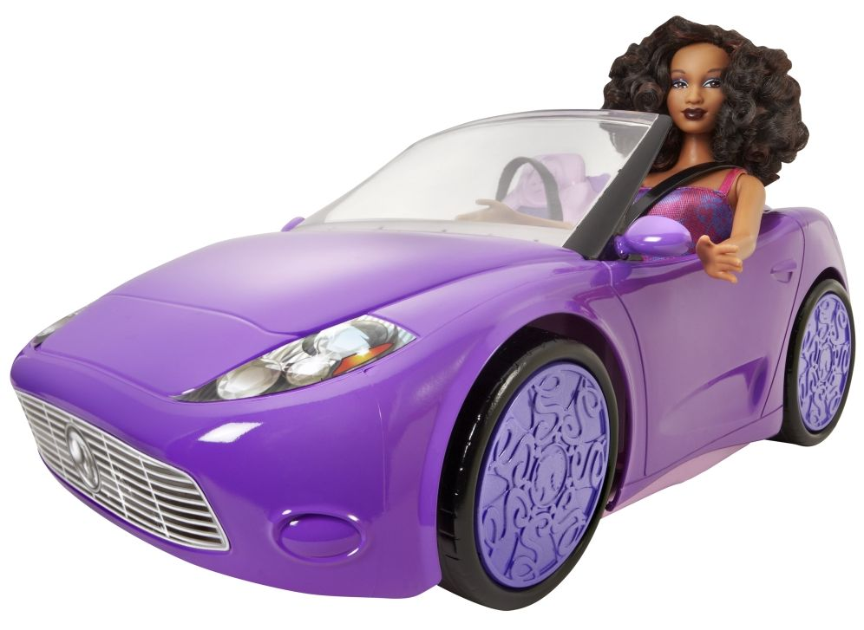
Sunday morning
Maria on her way to Brenda’s house at about 9:45.
Maria Garcia

Slide 21
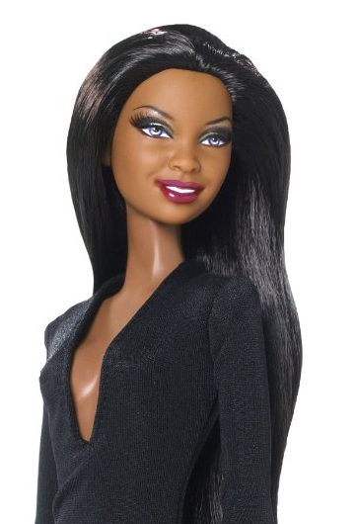
(09:55) Maria arrived at the house to take Brenda to the airport. She arrived early in order to spend time with her before leaving for the airport. She used her own key (Brenda gave her the key) to enter the home.

Slide 22
(10:00) Once upstairs, Maria found Brenda’s body face up in her bedroom. The victim was dressed in a cocktail dress and high heels. The dress was a going-away present from her mom.

Slide 23
Maria hurried downstairs to use the house phone and call 911.
She then went back upstairs to check on Mrs. McArthur.
Mrs. McArthur was nowhere to be found.

Slide 24
Sunday Morning:
10:22 to 10:35 Detectives, CSI personnel, and police arrive.
10:25 The crime scene is cordoned off.
10:28 Brenda’s body is pre-examined. Medical Examiner is called.
10:28 Colt firearm is found next to the body.
10:38 Maria is taken to the police station and questioned.

Slide 25
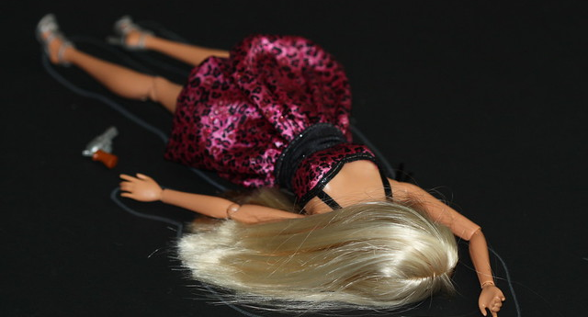
CSI photo from actual crime scene.

Slide 26
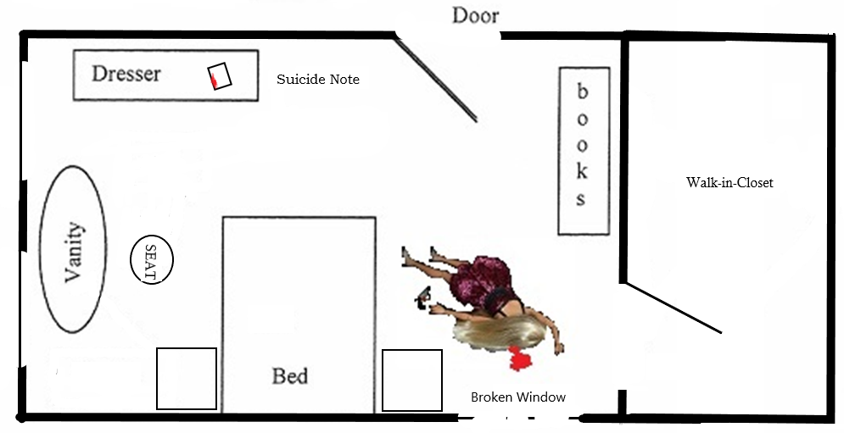

Slide 27
A 38-caliber Colt revolver was found on the floor next to the victim’s left hand. No blood was found on the weapon.

Slide 28
CSI Findings:
Two bullets were fired from the gun as evidenced by two empty shell casings in the revolver.
A single bullet was recovered from the victim’s bedroom.
Powder residue was found on the victim’s right hand.
The bullet entered through her left temple and exited through her right frontal bone above the right orbital cavity.

Slide 29
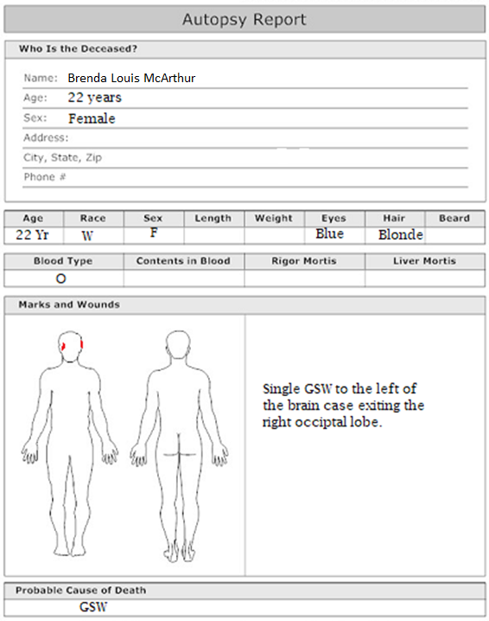
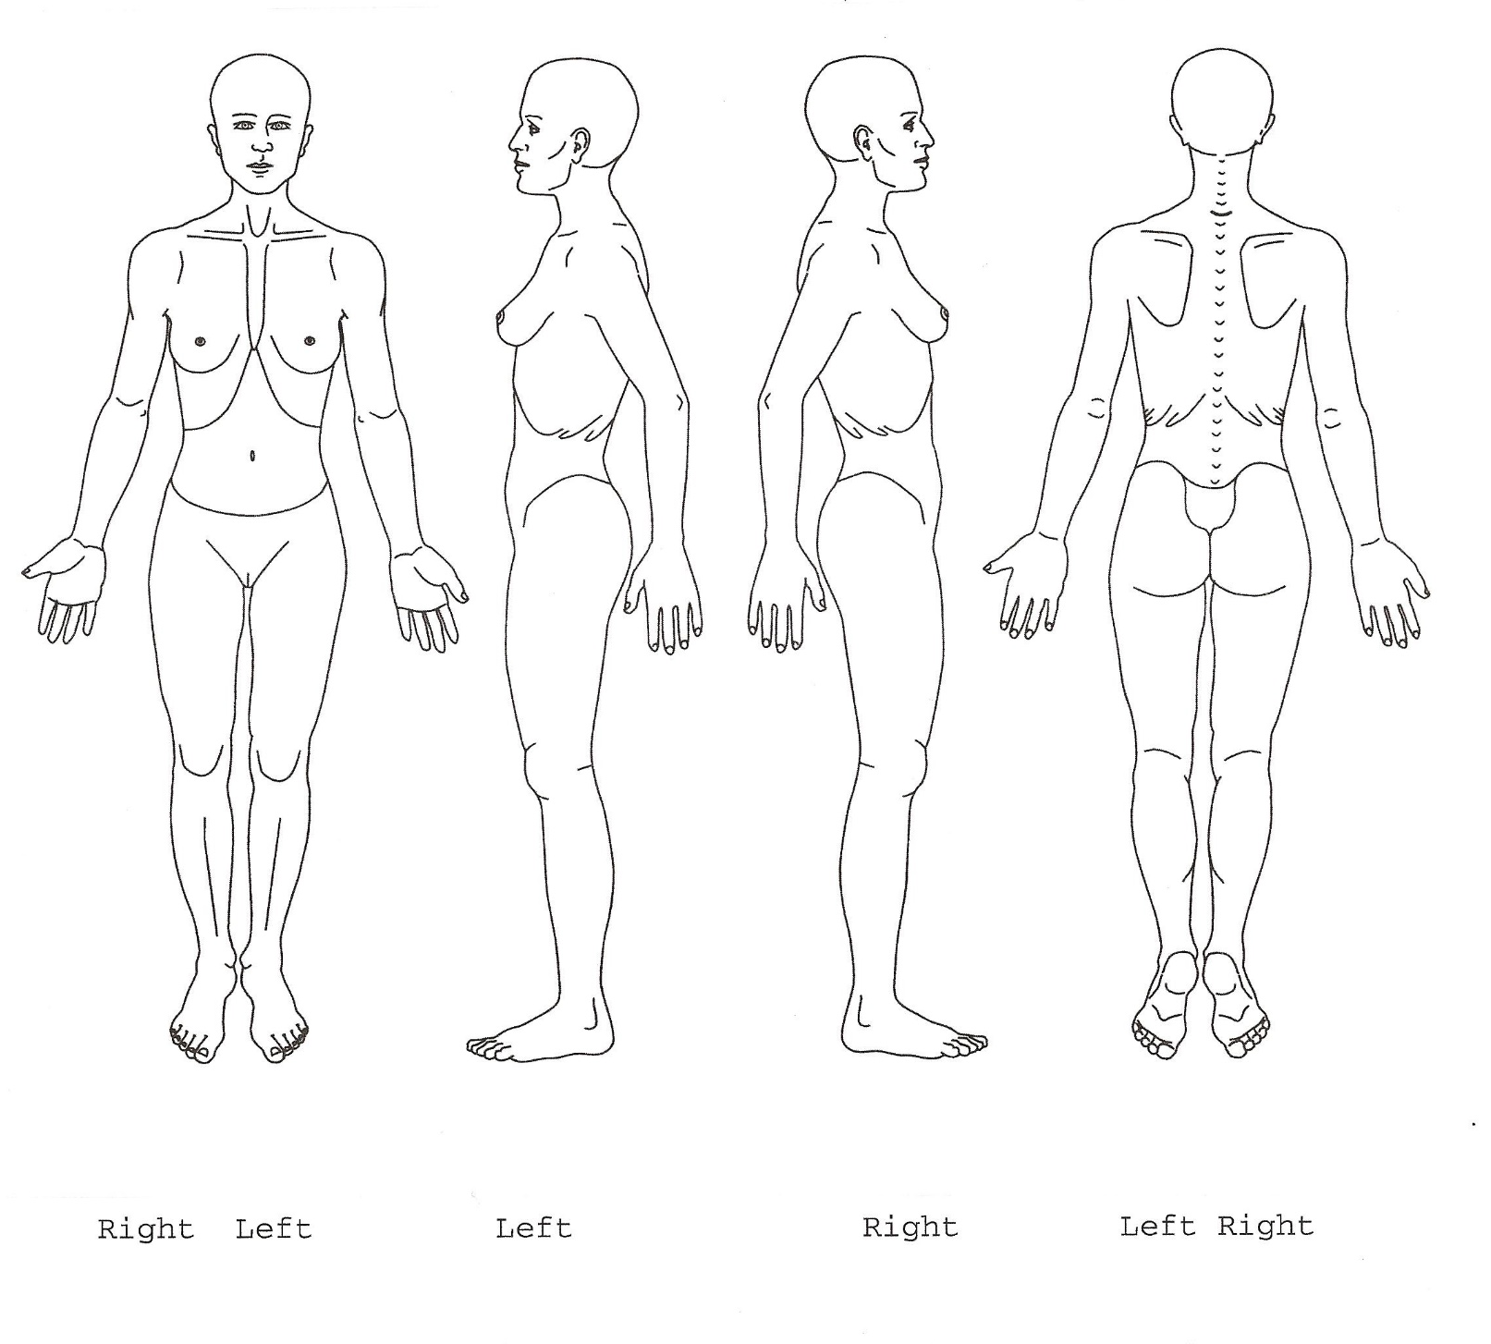
Entrance on left temporal bone.
Exit through frontal bone above the right orbital cavity.

Slide 30
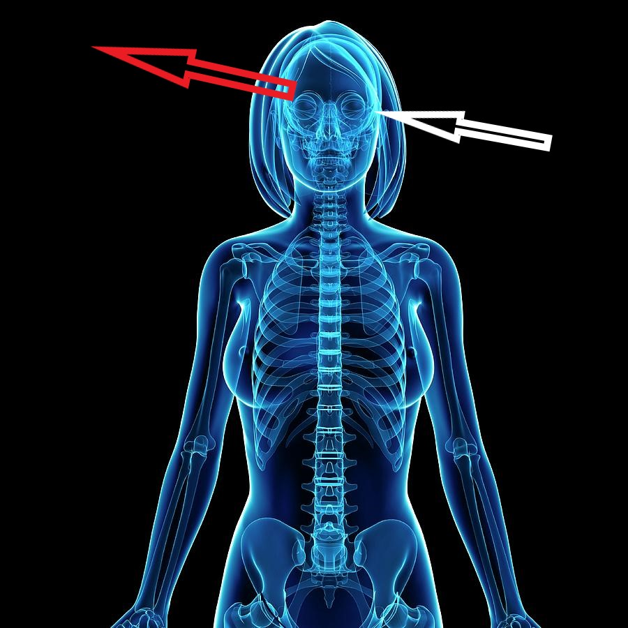

Slide 31
The victim was pronounced dead at the scene.
A suicide note was found on the dresser.
Blood was found on the edge of the note.
Hair found on the body and the gown was not the victim’s.
The second bullet was not found.

Slide 32
How the window was broken is unknown.
Airline tickets were found in Brenda’s handbag.
There were no powder burns on Brenda’s head.

Slide 33
The coroner suggested that the TOD was between 10 – 12 hours prior to the body being found.
So, 10:00 am Sunday morning when the body was found means that the TOD interval was from ________ until ___________. (You must determine the clock time.)

Slide 34
Your task:
Create a story that explains the murder be sure to use background information.
Include how it occurred and why.
You MUST answer the questions on the next two slides.
Minimum story length is 3 pages. Coversheet required. Either front and back or two separate pages. Please print or type. Extra pages = Extra credit
You may work with another student on this. However, the page length will increase. See me about it.

Slide 35
Answer the following in your story:
How did the killer get into the house?
Who was/were the killer(s)?
What was the motive?
Why didn’t Brenda’s mother hear the two shots?

Slide 36
Why was Hardbody at the house on Saturday night?
What was the content of the suicide note?
Who wrote the suicide note?
Was (Were) your killer(s) brought to justice?
What sentence was handed down by the court?

Slide 37
Suggestions:
Create an outline.
Now fill in between your outline statements.
If you need to add pages to your story, add dialog or interrogate the suspect at the jail.

Slide 38
Good Luck with this project.

