Slide 1
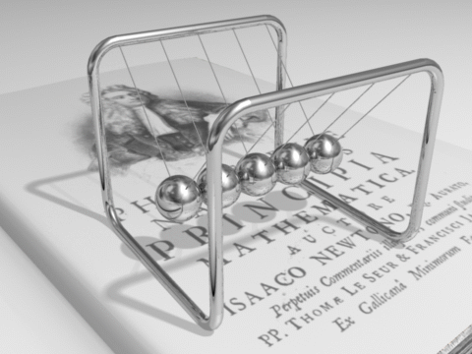
Conservation of Momentum
Physics
Mr. Waddell
From Mrs. Coyle
http://college.usc.edu/labs/physicsdemolab/mechanics/images/m8_5a.jpg

Slide 2
Conservation of Momentum

Slide 3
Conservation on Momentum
In the absence of an external force the momentum of a closed system is conserved.

Slide 4
Law of Conservation of Momentum
In a closed system, the vector sum of the momenta before and after an impact must be equal.
Before After
m₁v₁ +m₂v₂ = m₁v₁’ + m₂v₂’

Slide 5
Closed System:
A system that has no gain nor loss of mass.

Slide 6
Isolated System:
A closed system with no net external force acting on it.

Slide 7
Internal and External Forces
Internal Forces: act between objects within a system.
External Forces: are exerted by objects outside the system.

Slide 8
Question
A stationary firecracker explodes. What is the total momentum of the pieces that it breaks into?
Coyle ,4th of July 2009, Hudson River

Slide 9
Example: Recoiling Cannon

Slide 10
Example 1: Recoiling Cannon
A cannon of mass 750kg shoots a cannon
ball of mass 30kg with a velocity of 20m/s.
Find the recoil velocity of the cannon.
m₁v₁ +m₂v₂ = m₁v₁’ + m₂v₂’
Answer: -0.8m/s

Slide 11
Collisions
Elastic (Kinetic Energy is conserved)
Inelastic (Kinetic Energy is not conserved)
Deformed objects
Objects stick together
Note: Momentum is conserved in both types of collisions.

Slide 12
Example 2: Inelastic Collision
A bullet of mass 0.010kg is shot at a speed of 30m/s towards a 5kg stationary block. The bullet becomes embedded in the block an the two fly off together.
Find the speed with which they fly off.
Answer: 0.06m/s

Slide 13
Problem 3
A 45 kg student is riding on a 7kg scateboard with a velocity of +4m/s. The student jumps of the cart with a velocity of -1m/s. Find the velocity of the scateboard after the student jumped off.
Answer: +36m/s

