Slide 1

Section 1: Methods of Science
Scientific investigations do not always proceed with identical steps but do contain similar methods.
.
K What I Know | W What I Want to Find Out | L What I Learned

Slide 2
Essential Questions
What are the characteristics of scientific methods?
Why do scientists use models?
What is the difference between a scientific theory and a scientific law?
What are some limitations of science?
Methods of Science
Copyright © McGraw-Hill Education

Slide 3
Vocabulary
Review
control
New
physics
scientific methods
hypothesis
model
scientific theory
scientific law
Methods of Science
Copyright © McGraw-Hill Education

Slide 4
What is physics?
Physics is a branch of science that involves the study of the physical world: energy, matter, and how they are related.
The National Academy of Sciences defines science as “the use of evidence to form testable explanations and make predictions about natural phenomena, as well as the knowledge generated through this process.”
Methods of Science
Copyright © McGraw-Hill Education

Slide 5
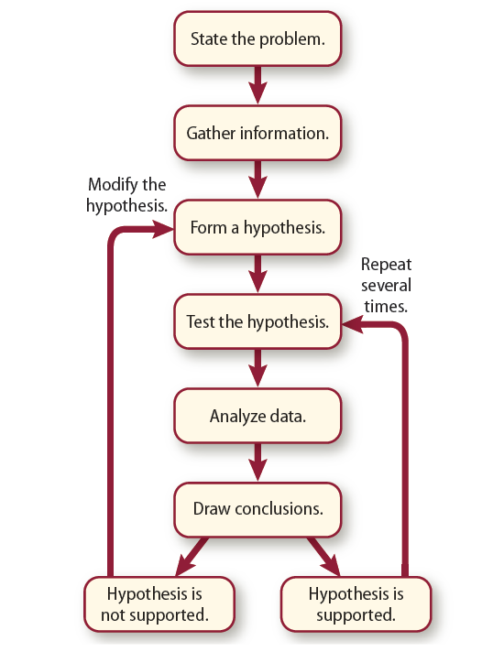
Scientific Methods
Although physicists do not always follow a rigid set of steps, investigations often follow similar patterns called scientific methods.
Depending on the particular investigation, a scientist might add new steps, repeat some steps or skip steps altogether.
Methods of Science
Copyright © McGraw-Hill Education

Slide 6
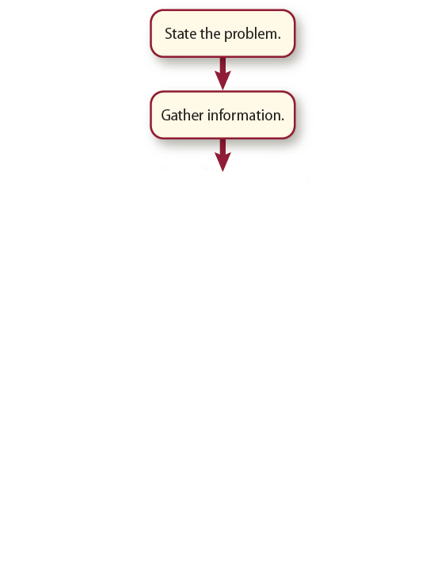
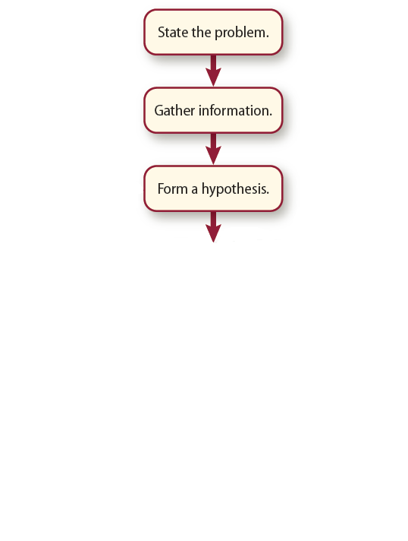

Scientific Methods
Many investigations begin when someone observes an event in nature and wonders why or how it occurs. The question of “why” or “how” is the problem.
Researching already known information about a problem, helps to fine-tune the question.
A hypothesis is a possible explanation for a problem using what you know and have observed.
Methods of Science
Copyright © McGraw-Hill Education

Slide 7
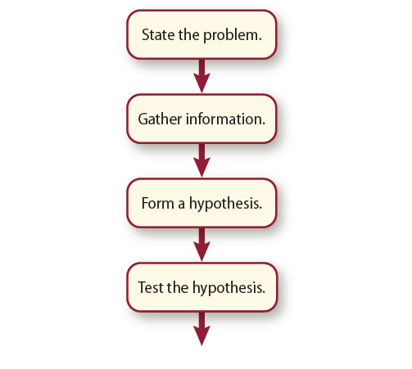
Scientific Methods
Hypotheses can be tested by:
  Observations
  Models
  Experiments
    Test the effect of one thing on another, using a control.
Methods of Science
Copyright © McGraw-Hill Education

Slide 8
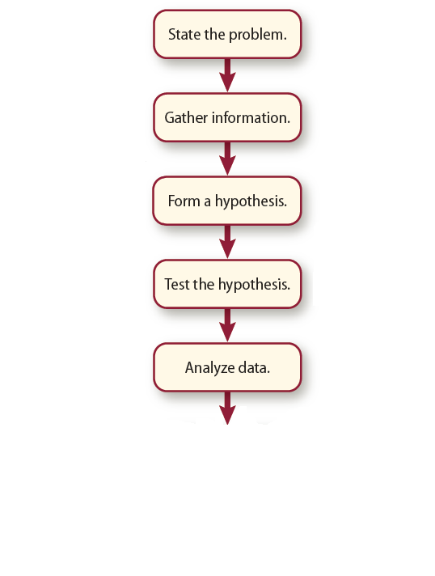
Scientific Methods
An important part of every investigation includes recording observations and organizing data into easy-to-read tables and graphs.
Based on the analysis of the data, the next step is to decide whether the hypothesis is supported.
  If supported, the data must be reproducible many times.
  If not supported, the hypothesis must be reconsidered.
Methods of Science
Copyright © McGraw-Hill Education

Slide 9
Models
A model is a representation of an idea, event, structure, or object that helps people better understand it.
Scientist use models when an object that is too large or too small, a process that takes too much time to see completely, or a material that is hazardous.
Examine the models below and explain why scientists might use models for these cases.
Quantum Model of the Atom
Gravitational Field Model
Ray Model of Light
Methods of Science
Copyright © McGraw-Hill Education

Slide 10
Scientific Theories and Laws
A scientific theory is an explanation of things or events based on knowledge gained from many observations and investigations.
  This is not a hypothesis, this is what a hypothesis becomes after numerous trials of data supporting the hypothesis.
  A theory is never permanent, it can change as new data and information becomes available.
Methods of Science
Copyright © McGraw-Hill Education

Slide 11
Scientific Theories and Laws
A scientific law is a statement about what happens in nature and seems to be true all the time.
  Laws tell you what will happen under certain conditions, but they do not explain why or how something happens.
    Ex. Gravity
    The law of gravity states that any one mass will attract another mass.
    There are many theories proposed to explain how the law of gravity works.
Methods of Science
Copyright © McGraw-Hill Education

Slide 12
The Limitations of Science
Science cannot explain or solve every question.
A scientific question must be testable and verifiable.
  Questions about opinions, values or emotions are not scientific because they cannot be tested.
  Determine if each of the following questions can be answered by science.
  How does a force change the motion of an object?
  Which season is best?
  How does a battery work?
  Was Mark Twain a good writer?
  Should we have pizza or hamburgers for lunch?
  Under what conditions is energy conserved?
  Can a plant live without light?
  can
  cannot
  can
  cannot
  cannot
  can
  can
Methods of Science
Copyright © McGraw-Hill Education

Slide 13
Review
Essential Questions
What are the characteristics of scientific methods?
Why do scientists use models?
What is the difference between a scientific theory and a scientific law?
What are some limitations of science?
Vocabulary
physics
scientific methods
hypothesis
model
scientific theory
scientific law
Methods of Science
Copyright © McGraw-Hill Education

