Slide 1

Section 3: Measurement
Making careful measurements allows scientists to repeat experiments and compare results.
K What I Know | W What I Want to Find Out | L What I Learned

Slide 2
Essential Questions
Why are the results of measurements often reported with an uncertainty?
What is the difference between precision and accuracy?
What is a common source of error when making a measurement?
Measurement
Copyright © McGraw-Hill Education

Slide 3
Vocabulary
Review
parallax
New
measurement
precision
accuracy
Measurement
Copyright © McGraw-Hill Education

Slide 4

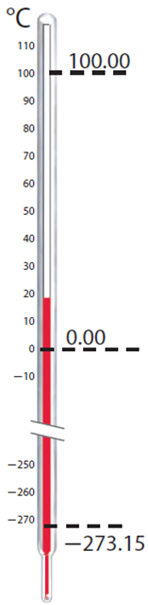
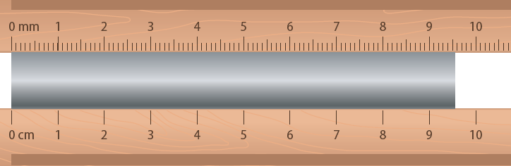
What is measurement?
A measurement is a comparison between an unknown quantity and a standard.
Measurements quantify observations.
Careful measurements enable you to derive the relationship between any two quantities.
Compile a list of quantities you might measure during your study of physics.
Measurement
Copyright © McGraw-Hill Education

Slide 5
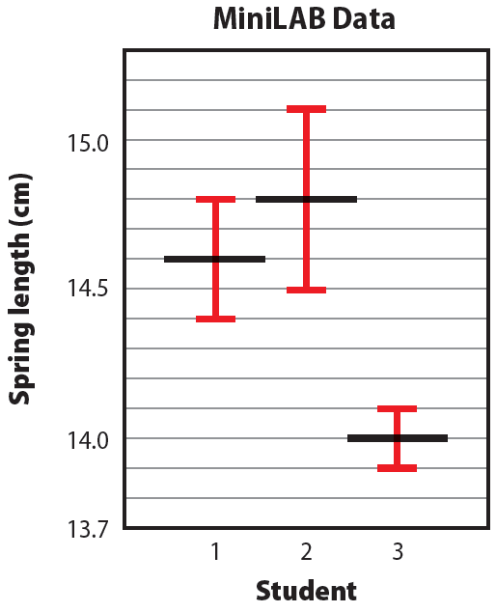
Comparing Results
Measurements are often reported with uncertainty.
A new measurement that is within the margin of uncertainty confirms the old measurement.
For example, the ranges for the measurements of Student 1 and Student 2 overlap.
Measurement
Copyright © McGraw-Hill Education

Slide 6
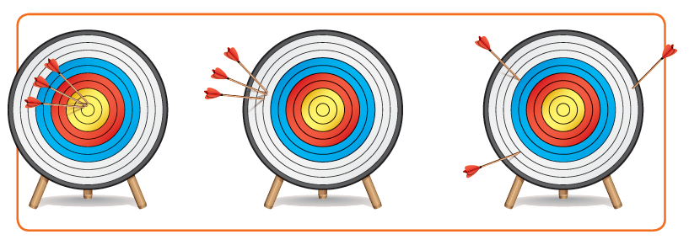
Precision Versus Accuracy
Precision is the degrees of exactness of a measurement.
Accuracy describes how well the results of a measurement agree the accepted value.
Precise Precise Imprecise
Accurate Inaccurate Inaccurate
Measurement
Copyright © McGraw-Hill Education

Slide 7
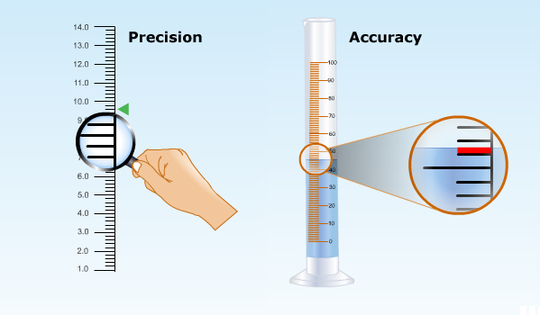
Precision Versus Accuracy
Concepts in Motion
Measurement
Copyright © McGraw-Hill Education

Slide 8
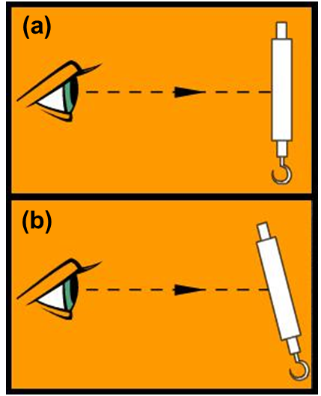
Techniques of Good Measurement
To assure precision and accuracy, instruments used to make measurements need to be used correctly.
Scales should be read with one’s eye straight in front of the measure.
If the scale is read from an angle, as shown in figure (b), you will get a different, and less accurate, value.
Measurement
Copyright © McGraw-Hill Education

Slide 9
Review
Essential Questions
Why are the results of measurements often reported with an uncertainty?
What is the difference between precision and accuracy?
What is a common source of error when making a measurement?
Vocabulary
measurement
precision
accuracy
Measurement
Copyright © McGraw-Hill Education

