Slide 1

Section 4: Graphing Data
Graphs make it easier to interpret data, identify trends and show relationships among a set of variables.
K What I Know | W What I Want to Find Out | L What I Learned

Slide 2
Essential Questions
What can be learned from graphs?
What are some common relationships in graphs?
How do scientists make predictions?
Graphing Data
Copyright © McGraw-Hill Education

Slide 3
Vocabulary
Review
slope
New
independent variable
dependent variable
line of best fit
linear relationship
quadratic relationship
inverse relationship
Graphing Data
Copyright © McGraw-Hill Education

Slide 4
Identifying Variables
A variable is any factor that might affect the behavior of an experimental setup.
The independent variable is the factor that is changed or manipulated during the experiment.
The dependent variable is the factor that depends on the independent variable.
Graphing Data
Copyright © McGraw-Hill Education

Slide 5
Identifying Variables
Graphs are one way to communicate data. They can show how the dependent variable changes with the independent variable.
A line graph shows how the dependent variable changes with the independent variable.
The line of best fit is drawn as close to all the data points as possible.
  The line of best fit is a better model for predictions than any one point along the line.
Graphing Data
Copyright © McGraw-Hill Education

Slide 6
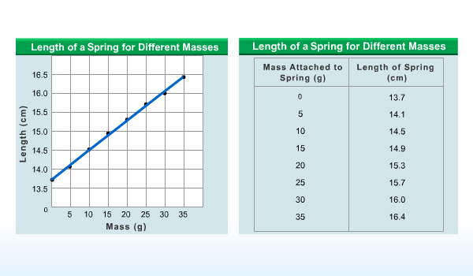
Identifying Variables
Concepts in Motion
Graphing Data
Copyright © McGraw-Hill Education

Slide 7
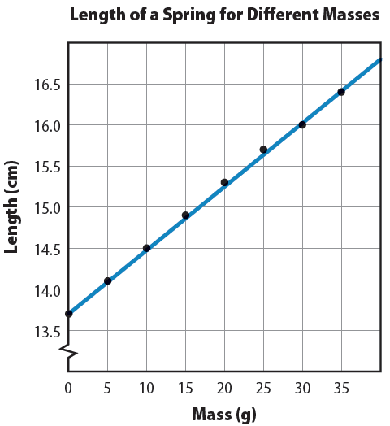
Linear Relationships
When the line of best fit is a straight line, there is a lineal relationship between the two variables.
In a linear relationship, the dependent variable varies linearly with the independent variable.
A linear relationship can be written as an equation: y = mx + b.
  b is the y-intercept (the point at which the line crosses the y-axis)
  m is the slope of the line and can be found using the equation
Graphing Data
Copyright © McGraw-Hill Education

Slide 8
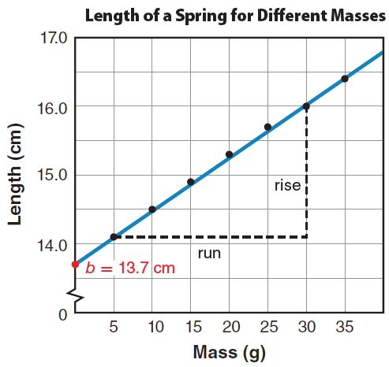
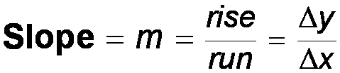
Linear Relationships
The slope is the ratio of the vertical change to the horizontal change. To find the slope, select two points, A and B, far apart on the line. The vertical change, or rise, Δy, is the difference between the vertical values of A and B. The horizontal change, or run, Δx, is the difference between the horizontal values of A and B.
Graphing Data
Copyright © McGraw-Hill Education

Slide 9
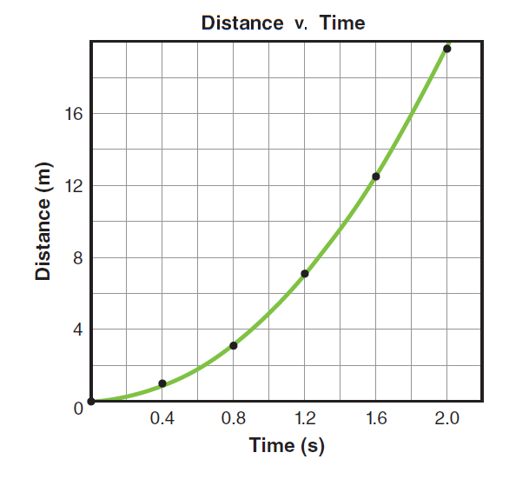
Nonlinear Relationships
When the graph is not a straight line, it means that the relationship between the dependent variable and the independent variable is not linear.
There are many types of nonlinear relationships in science. Two of the most common are the quadratic and inverse relationships.
A quadratic relationship exists when one variable depends on the square of another.
A quadratic relationship can be represented by the following equation:
y = ax² + bx + c
Graphing Data
Copyright © McGraw-Hill Education

Slide 10
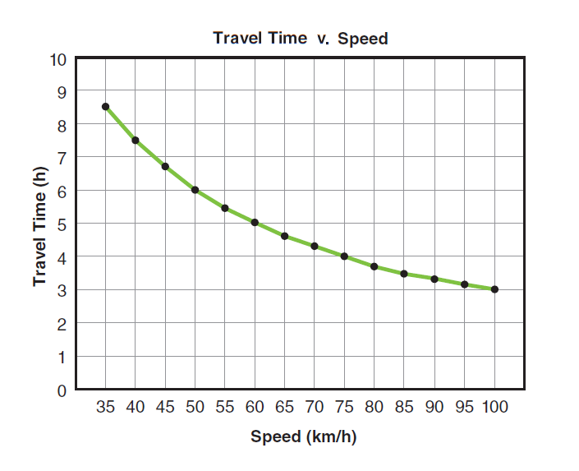
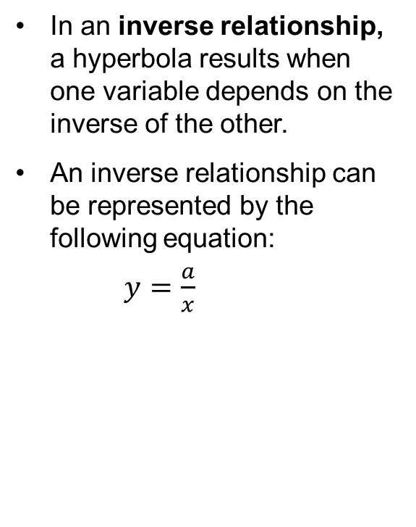
Nonlinear Relationships
In an inverse relationship, a hyperbola results when one variable depends on the inverse of the other.
An inverse relationship can be represented by the following equation:
$y=\frac{a}{x}$
Graphing Data
Copyright © McGraw-Hill Education

Slide 11
Nonlinear Relationships
There are various mathematical models available apart from the three relationships you have learned. Examples include sinusoids, which are used to model cyclical phenomena, and exponential decay curves, which are used to model radioactivity.
Combinations of different mathematical models represent even more complex phenomena.
Graphing Data
Copyright © McGraw-Hill Education

Slide 12
Predicting Values
Relations, either learned as formulas or developed from graphs, can be used to predict values you have not measured directly.
Physicists use models to accurately predict how systems will behave: what circumstances might lead to a solar flare, how changes to a circuit will change the performance of a device, or how electromagnetic fields will affect a medical instrument.
Graphing Data
Copyright © McGraw-Hill Education

Slide 13
Review
Essential Questions
What can be learned from graphs?
What are some common relationships in graphs?
How do scientists make predictions?
Vocabulary
independent variable
dependent variable
line of best fit
linear relationship
quadratic relationship
inverse relationship
Graphing Data
Copyright © McGraw-Hill Education

